Slide 1
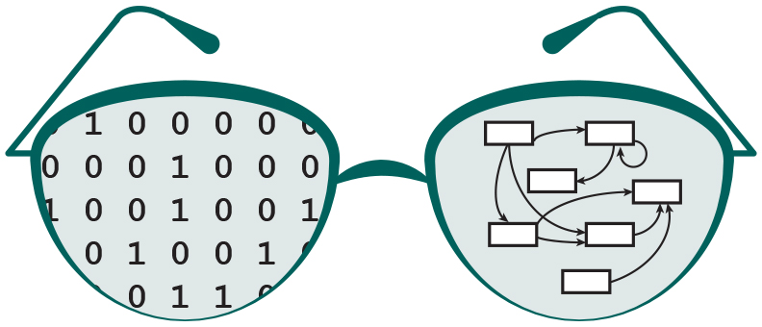

GRNsight v2: a web application for visualizing models of small gene regulatory networks
Eileen J. Choe, Nicole A. Anguiano, Anindita Varshneya, Mihir Samdarshi, Yeon-Soo Shin, Edward B. Bachoura, John David N. Dionisio, and Kam D. Dahlquist
Department of Electrical Engineering and Computer Science
Department of Biology
Loyola Marymount University
Saturday, October 28, 2017
SWE Rapid Talk - Undergraduate
Notes:
My name is Eileen Choe and today I am presenting GRNsight v2: a web application for visualizing models of small gene regulatory networks.
GRNsight is an ongoing interdisciplinary research project at Loyola Marymount University which is a collaboration between the departments of electrical engineering and computer science and the department of biology.

Slide 2
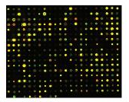
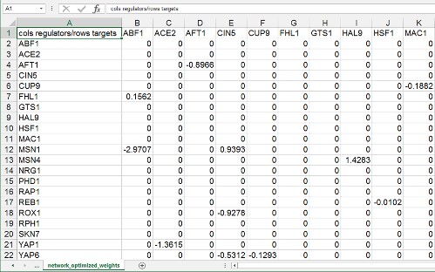
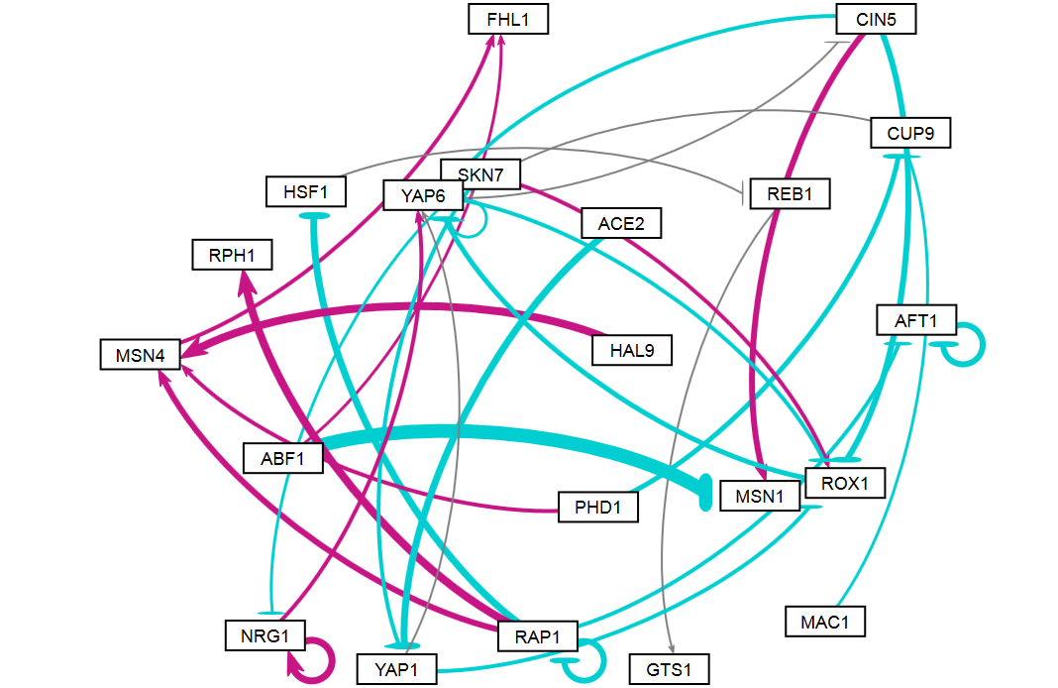
Introduction: Data Visualization
How do we understand complex relationships in gene regulatory network (GRN) data?
GRNsight is a web application optimized for small graphs which produces easily interpretable visualizations.
DNA microarray experiments
GRNmap modeling output
GRNsight visualization
Notes:
There’s a lot of data being generated across different domains, and with this comes a need to develop tools to understand data.
For example, biologists often have difficulty understanding the complicated relationships in gene regulatory network data from viewing the raw data generated from their experiments.
There are two related research groups at LMU-- the Dahlquist lab which designs and runs DNA microarray experiments, and GRNmap, which models the dynamics of gene regulatory networks using differential equations. GRNmap outputs data in the form of an Excel Spreadsheet, however, data in this format is still dense difficult to understand.
GRNsight solves this problem through data visualization. GRNsight is a web application optimized for small graphs which produces easily interpretable and customizable visualizations.
The goal of data visualization is to close the cognitive gap between data and insight through visual encoding. For GRNsight, our goal is to help biologists to ask new questions, and design new experiments.

Slide 3
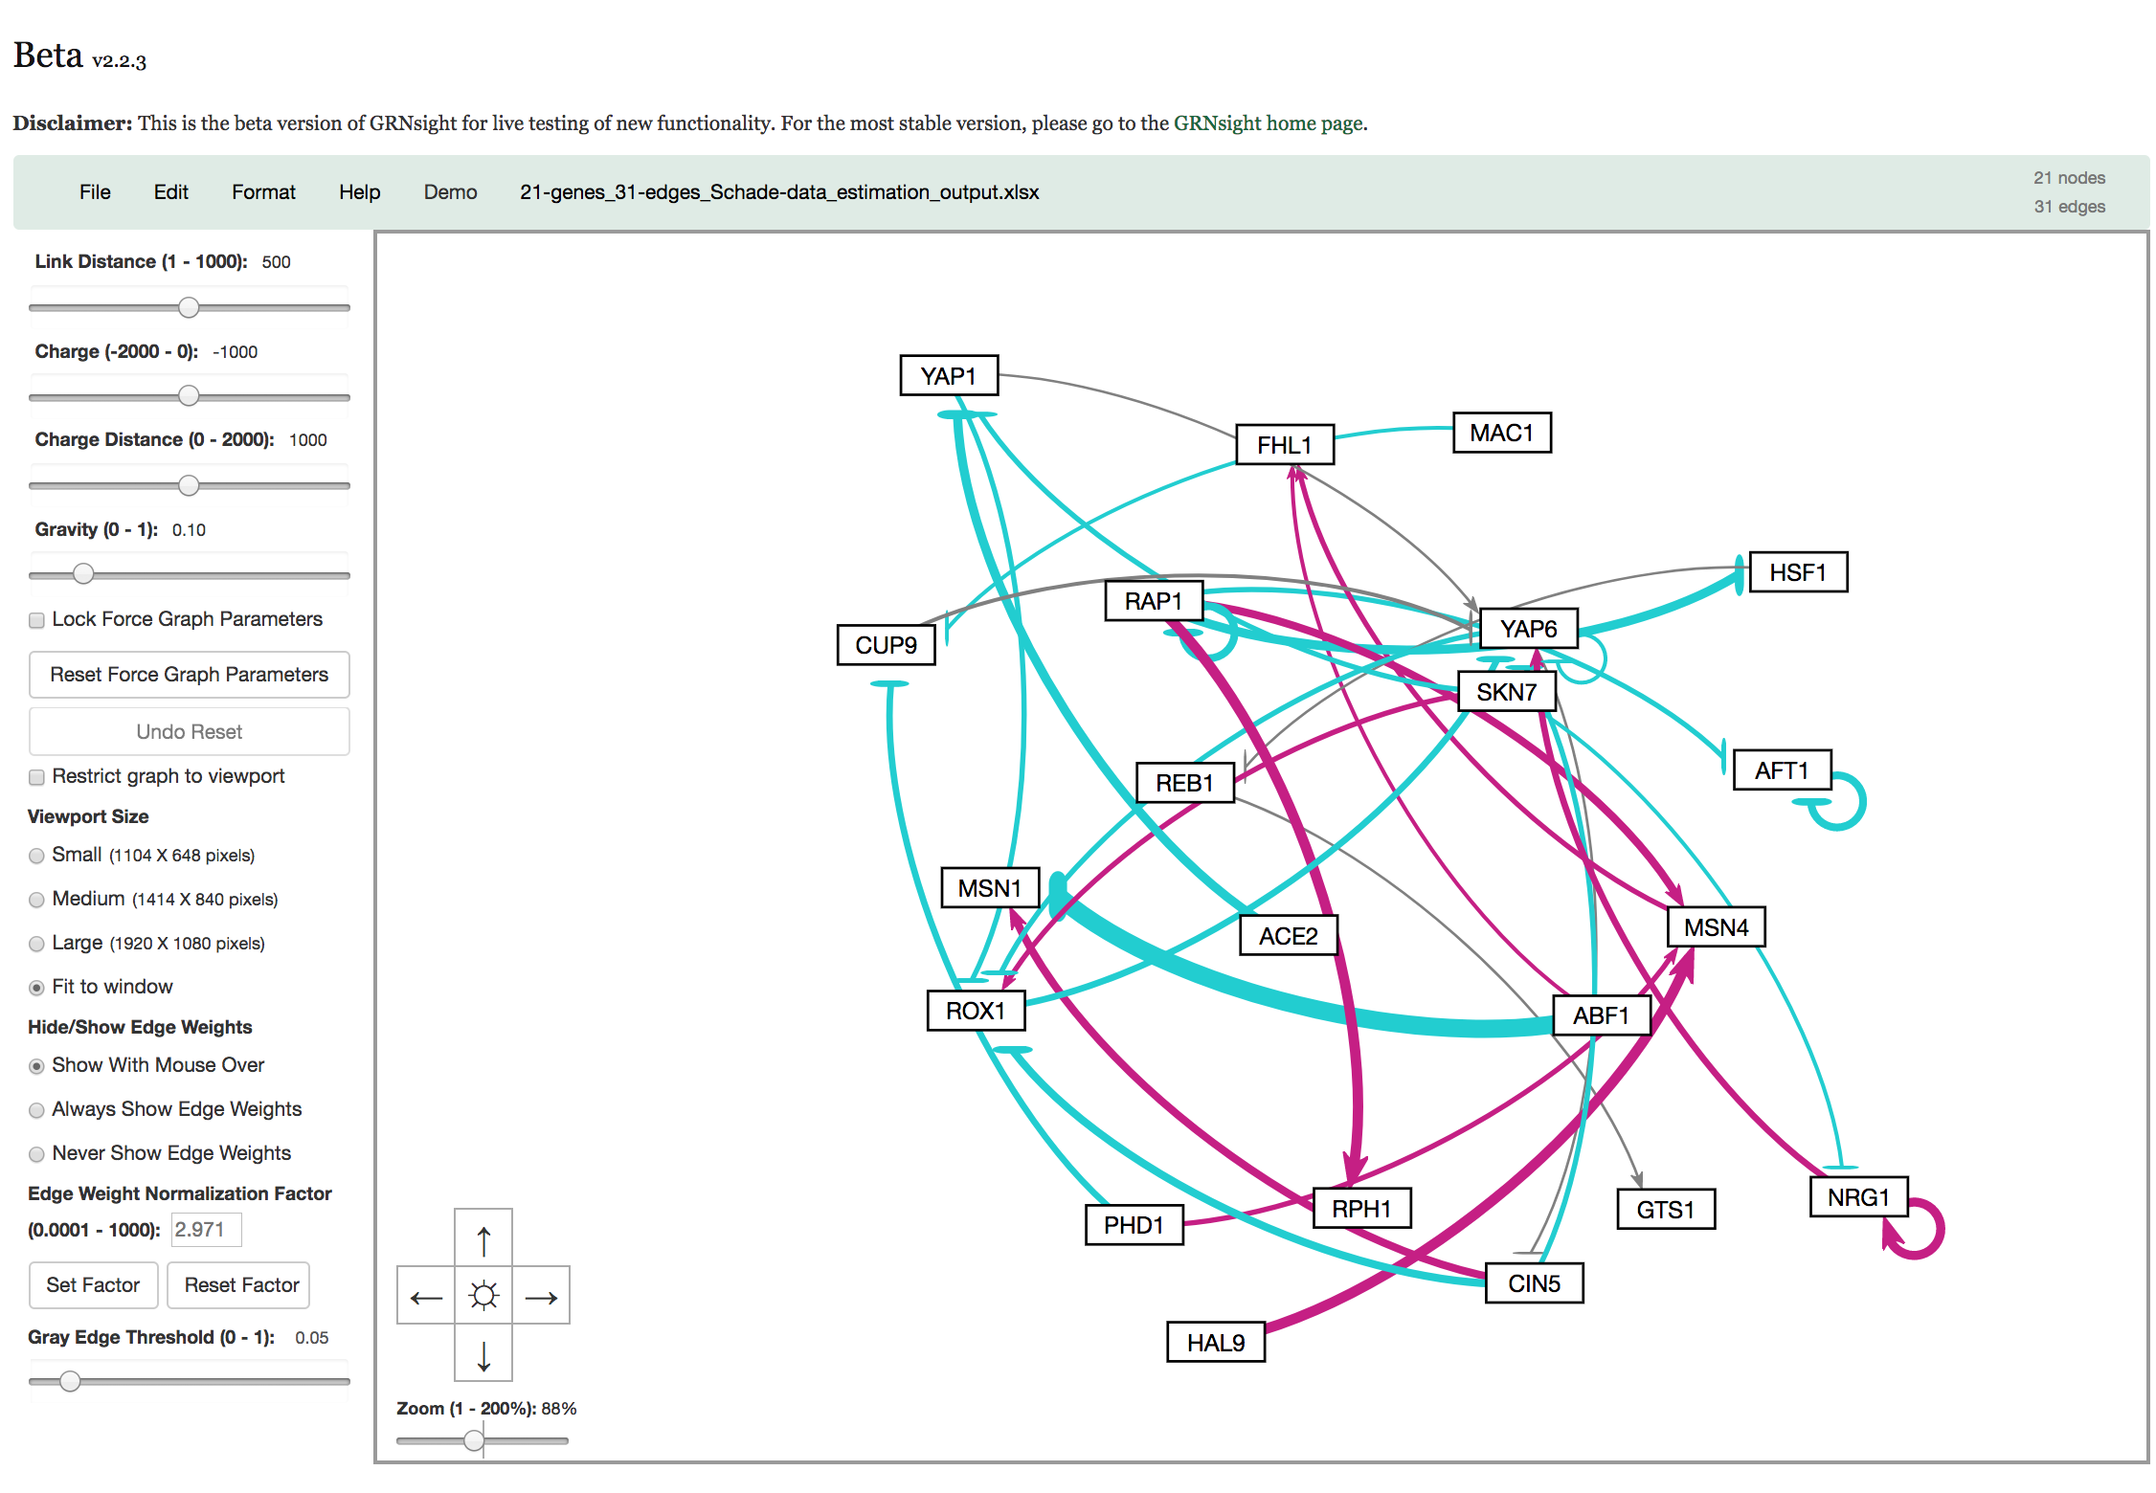
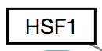
GRNsight v1 (Aug 2016)
Key:
gene
activation
repression
weak influence
How can GRNsight be improved to better facilitate understanding of networks?
Notes:
GRNsight v1 was released on….
GRNsight automatically lays out force directed networks from adjacency matrix inputs.
GRNsight uses rectangular nodes representing genes, and arrows representing various regulatory relationships.
The user interface on the left panel, allows the user to modify force graph parameters, which apply physics simulation to the graph.
From user feedback of GRNsight v1, our research objective was to improve GRNsight’s analytical and visual capabilities of networks.

Slide 4



Objectives
Approach
Add the following feature set to GRNsight v2:
Analytical Features
Normalization
Gray edge customization
Display Features
Separation of separation of bounding box from viewport
Restrict Graph to Viewport
Tests
Client Side Test Generator
SIF / GraphML syntactic and semantic tests
Test driven development
JavaScript programming language on client and server side
Technology Stack:

Slide 5
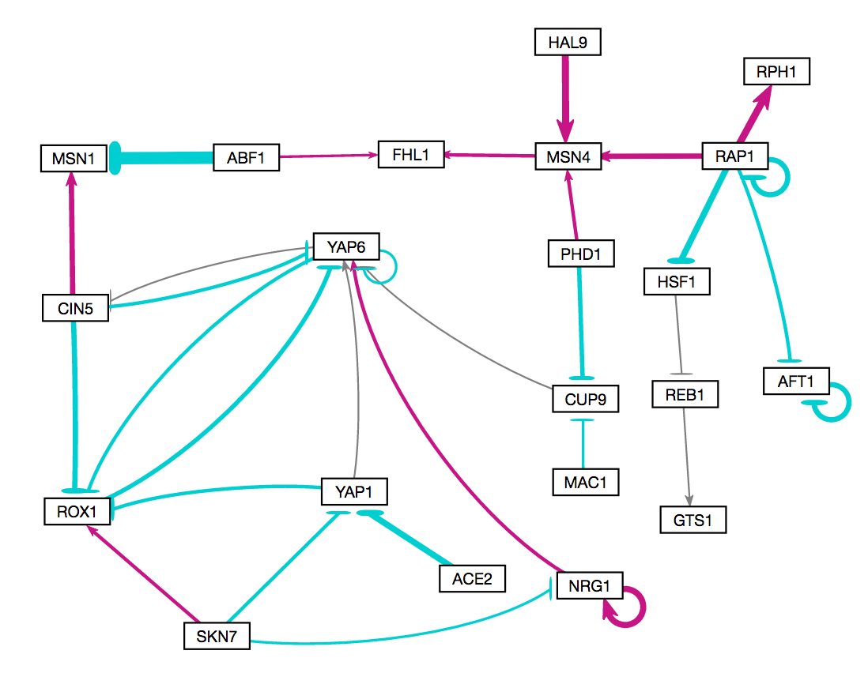
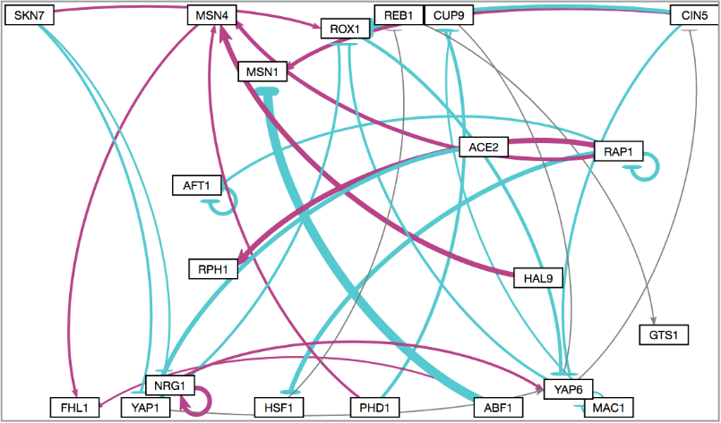
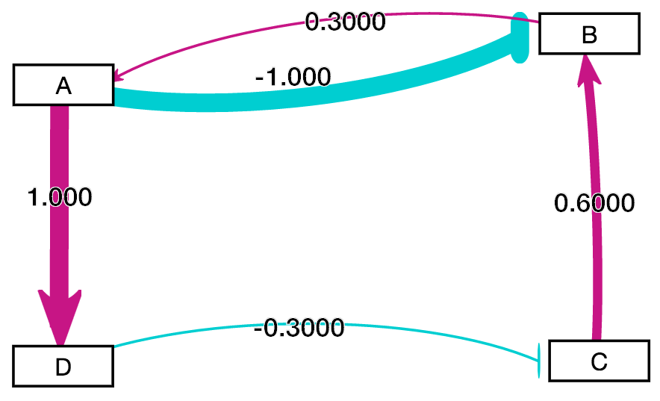
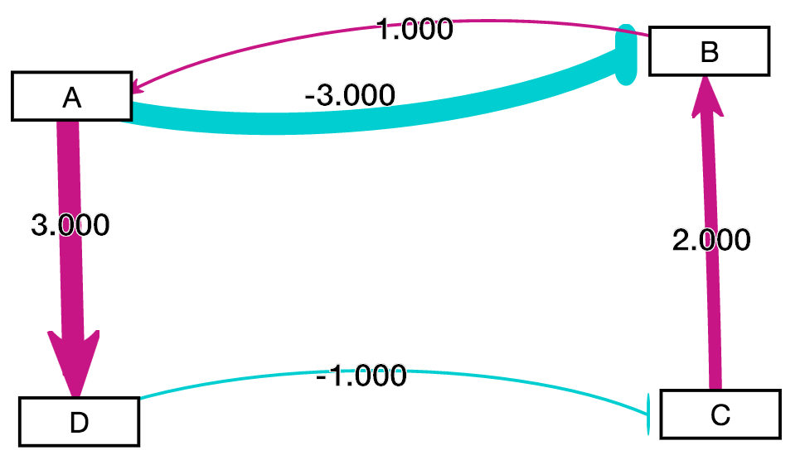
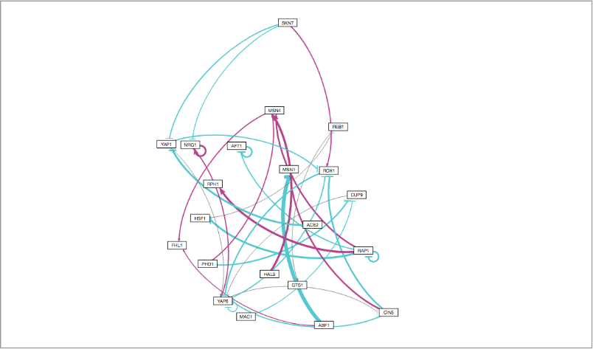
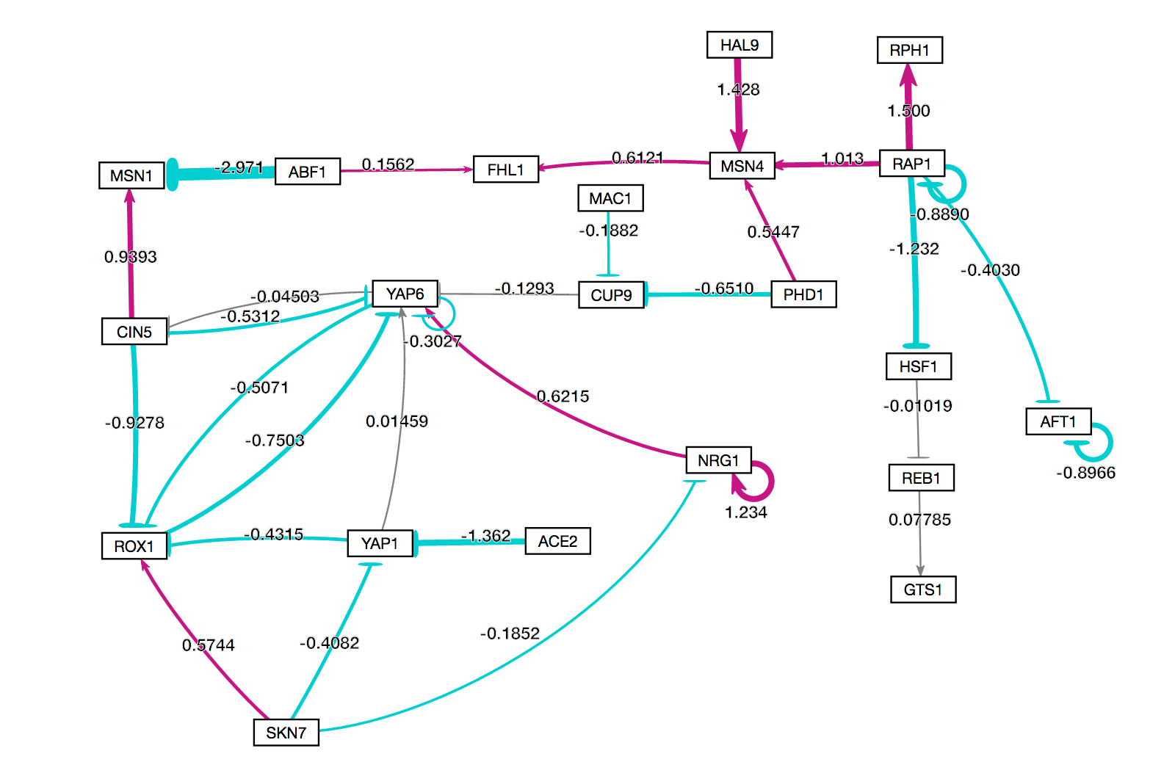
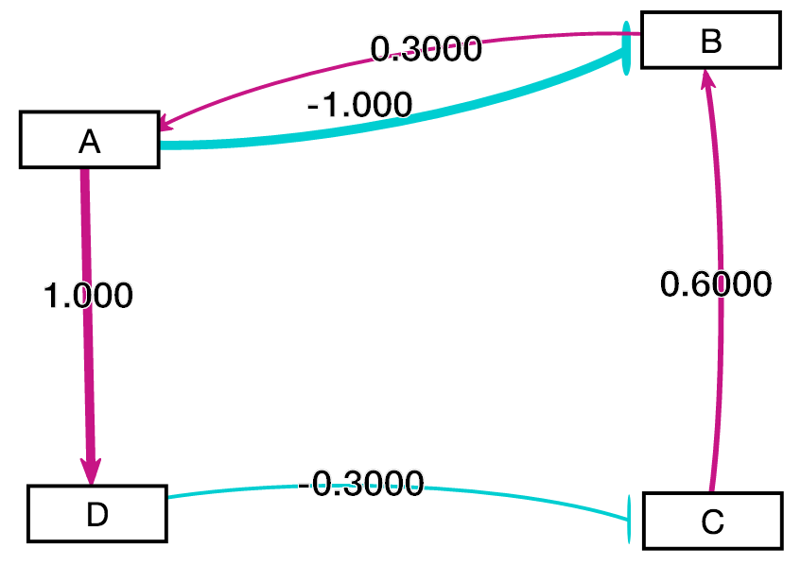
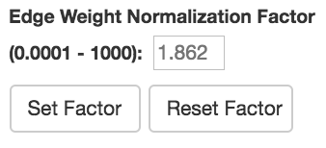
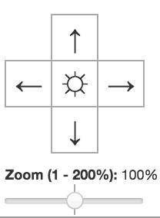
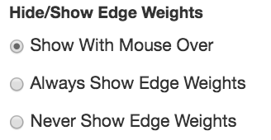
Results
Separation of bounding box from viewport
Edge Weight Display
Normalization
Edge Weight Display Options
Normalization
GRNsight v1
GRNsight v2
Notes:
Here’s a matrix of our research results, highlighting a subset of the features added in GRNsight v2.
In GRNsight v2, the graph bounding box is separated from the viewport and is allowed to expand as far as required for the graph to converge to a steady-state, allowing the force graph parameters to be fully applied. Because of this change, the ability for the user to zoom and scroll the graph within the viewport was added.
In GRNsight v2, menu options were added to always or never show edge weight values
In GRNsight v2, the ability to customize the edge thickness normalization factor allows comparison of multiple graphs so that the thicknesses of the edges will be on the same scale.

Slide 6
Conclusions & Future Directions
GRNsight's v2’s features improve the interpretation of models of gene regulatory networks, based on feedback from end-users.
Applicability:
GRNsight has general applicability for visualizing network graphs across different domains.
Future work:
Node coloring feature to visualize temporal gene expression data

Slide 7
Backup Slides

Slide 8
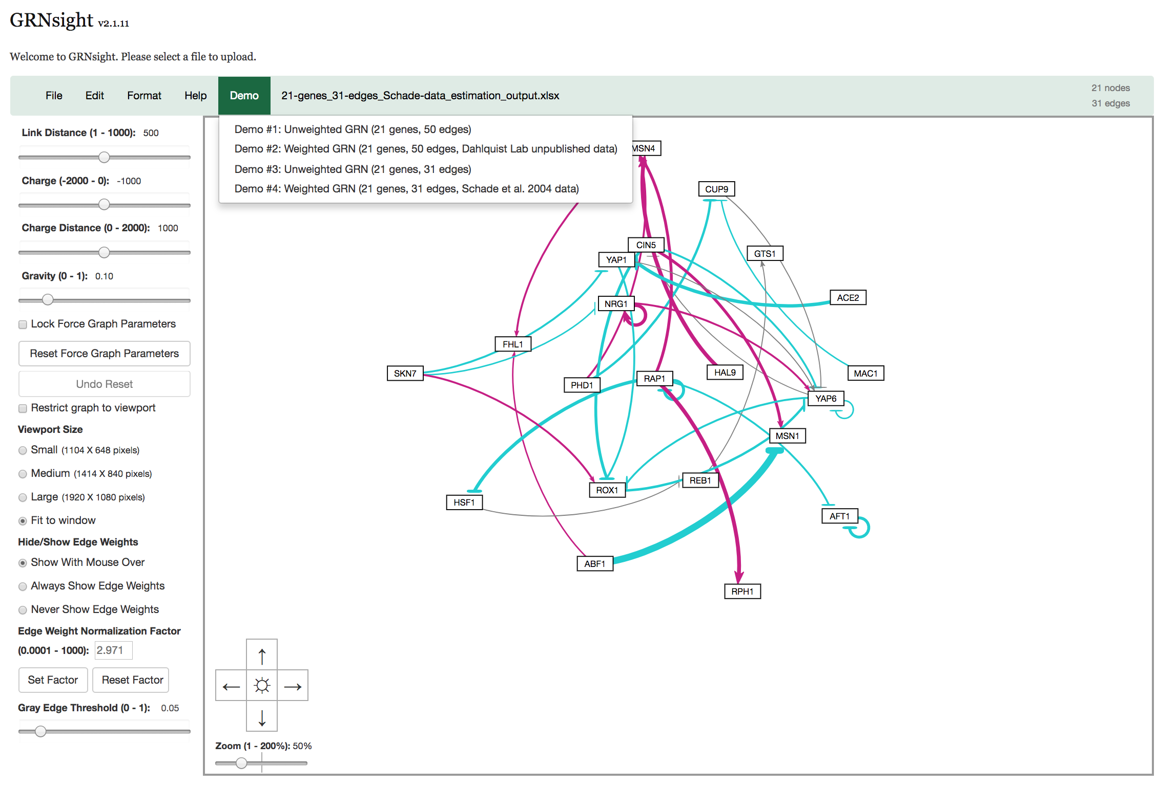
GRNsight v2.1.11 (master) Screenshot

Slide 9
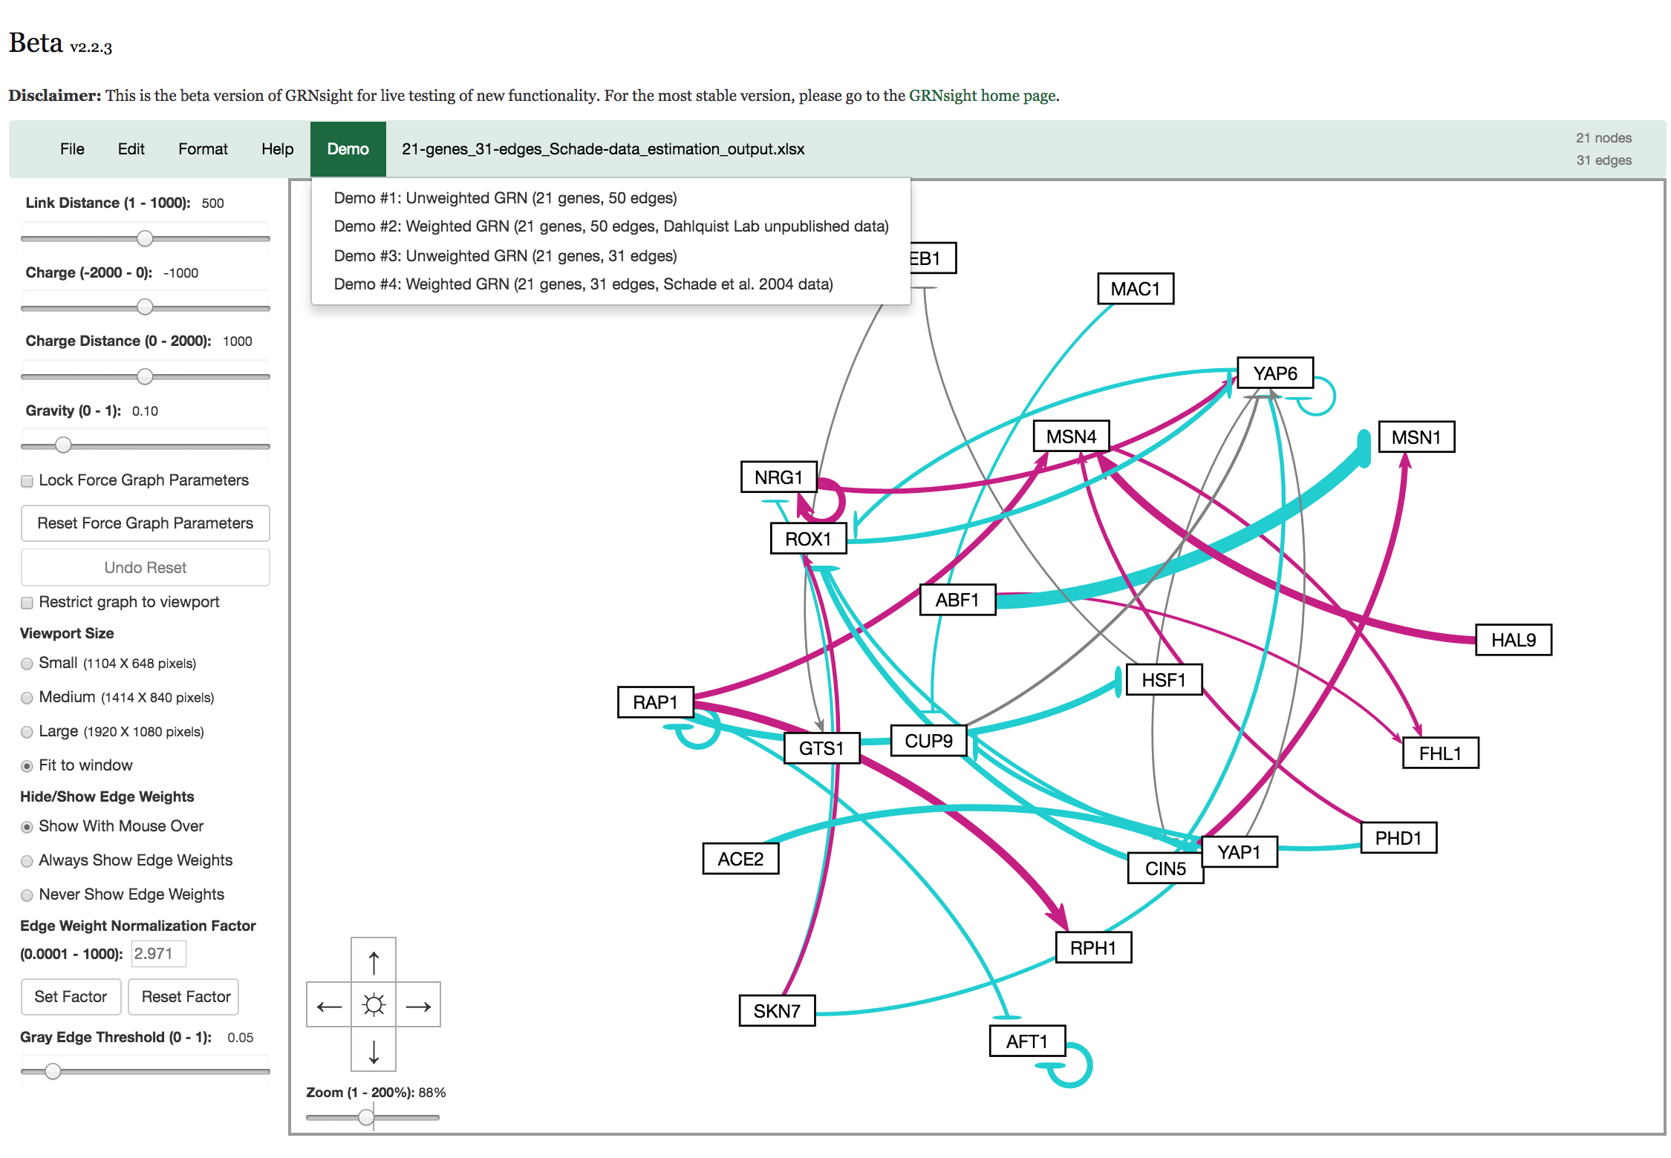
GRNsight v2.2.3 (beta) Screenshot

Slide 10
Continuous Integration
Developer commits code on a branch or fork
Travis C.I. Build Initiated
Coveralls Code Coverage Tool Initiated
Pull Request Submitted

Slide 11
Key:
activation
repression
weak influence

Slide 12
Outline
Yeast respond to cold shock by changing gene expression.
But little is known about which transcription factors regulate the response.
GRNmap models the dynamics of “medium-scale” gene regulatory networks using differential equations.
A penalized least squares approach was used successfully to estimate parameters from cold shock microarray data.
GRNsight automatically generates weighted network graphs from the spreadsheets produced by GRNmap.
This facilitates visualization of the relative influence of each transcription factor in controlling the cold shock response.

Slide 13
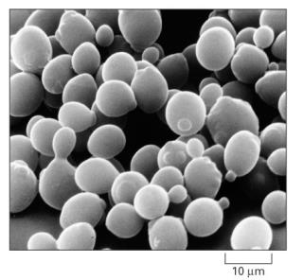
Yeast Respond to Cold Shock by Changing Gene Expression
Unlike heat shock, cold shock is not well-studied.
Cold shock temperature range for yeast is
10-18°C.
Previous studies indicated that the cold shock response can be divided into an early and late response.
General Environmental Stress Response (ESR) genes are induced in the late response.
Late response is regulated by the Msn2/Msn4 transcription factors.
No “canonical” factor responsible for early response.
Alberts et al. (2004)

Slide 14
Yeast Respond to Cold Shock by Changing Gene Expression
Unlike heat shock, cold shock is not well-studied.
Cold shock temperature range for yeast is
10-18°C.
Previous studies indicated that the cold shock response can be divided into an early and late response.
General Environmental Stress Response (ESR) genes are induced in the late response.
Late response is regulated by the Msn2/Msn4 transcription factors.
No “canonical” factor responsible for early response.
Alberts et al. (2004)
Which transcription factors control the early response?
What are their relative levels of influence?
I.e., what are the indirect effects of other transcription factors in the network?

Slide 15
Systems Biology Approach to Understanding the Regulation of the Cold Shock Response in Yeast
Cold shock microarray data from wt and TF deletion strains

Slide 16
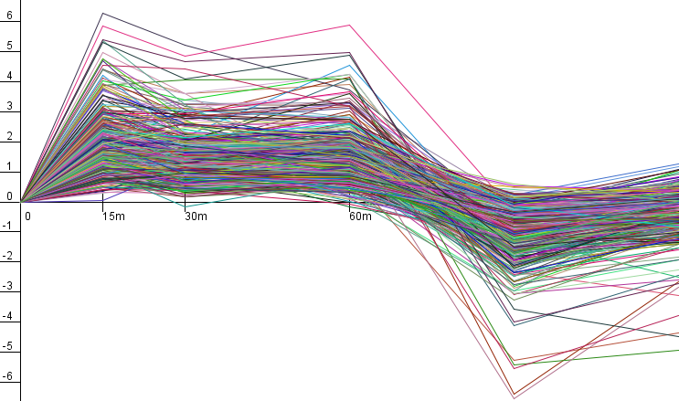
Systems Biology Approach to Understanding the Regulation of the Cold Shock Response in Yeast
Cold shock microarray data from wt and TF deletion strains
Normalization, statistical analysis, clustering

Slide 17
Systems Biology Approach to Understanding the Regulation of the Cold Shock Response in Yeast
Cold shock microarray data from wt and TF deletion strains
Normalization, statistical analysis, clustering
Derivation of gene regulatory networks from YEASTRACT

Slide 18
Systems Biology Approach to Understanding the Regulation of the Cold Shock Response in Yeast
Cold shock microarray data from wt and TF deletion strains
Normalization, statistical analysis, clustering
Derivation of gene regulatory networks from YEASTRACT
Dynamical systems modeling using GRNmap

Slide 19
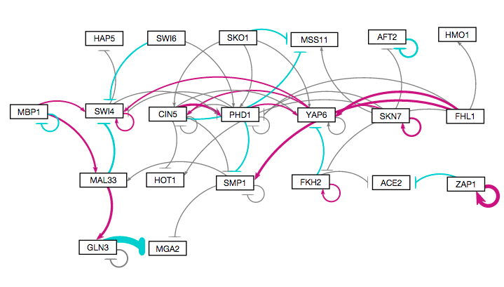
Systems Biology Approach to Understanding the Regulation of the Cold Shock Response in Yeast
Cold shock microarray data from wt and TF deletion strains
Normalization, statistical analysis, clustering
Visualization of modeling results using GRNsight
Derivation of gene regulatory networks from YEASTRACT
Dynamical systems modeling using GRNmap

Slide 20
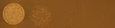
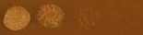
Systems Biology Approach to Understanding the Regulation of the Cold Shock Response in Yeast
wt
Cold shock microarray data from wt and TF deletion strains
15°C
Δash1
Interpretation,
new questions, new experiments
Normalization, statistical analysis, clustering
Visualization of modeling results using GRNsight
Derivation of gene regulatory networks from YEASTRACT
Dynamical systems modeling using GRNmap

Slide 21
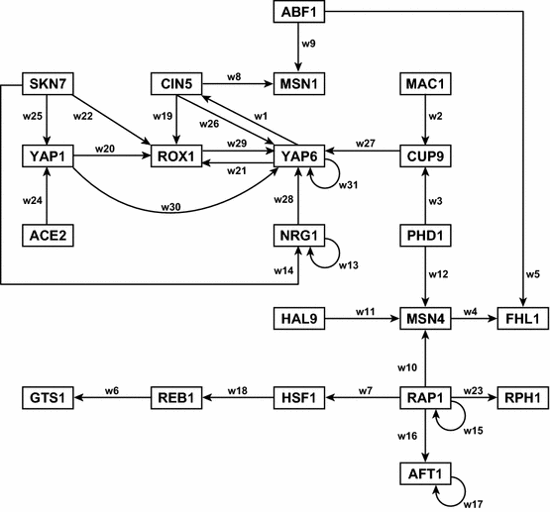
A “Medium-Scale” Gene Regulatory Network that Regulates the Cold Shock Response
Assumptions made in our model:
Each node represents one gene encoding a transcription factor.
When a gene is transcribed, it is immediately translated into protein.
A node represents the gene, the mRNA, and the protein.
Each edge represents a regulatory relationship, either activation or repression, depending on the sign of the weight.
Dahlquist et al. (2015) Bulletin of Mathematical Biology 77: 1457.

Slide 22
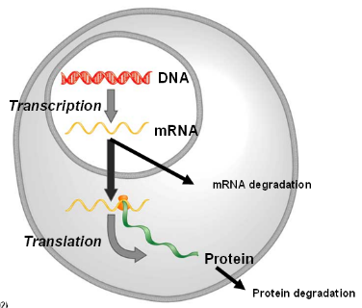
GRNmap: Gene Regulatory Network Modeling and Parameter Estimation
The user has a choice to model the dynamics based on a sigmoidal (shown) or Michaelis-Menten production function.
Weight parameter, w, gives the direction (activation or repression) and magnitude of regulatory relationship.
http://kdahlquist.github.io/GRNmap/

Slide 23
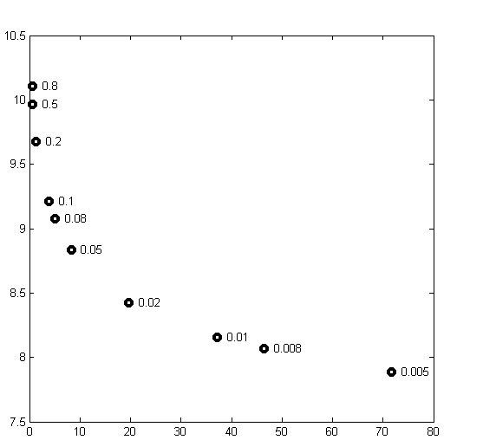
Optimization of the Large Number of Parameters Required the Use of a Regularization (Penalty) Term
Total number of parameters is
(2 X no. of genes) + no. of edges.
We added a penalty term so that MATLAB’s optimization algorithm would be able to minimize the function.
θ is the combined production rate, weight, and threshold parameters.
α is determined empirically from the “elbow” of the L-curve.
Least Squares Residual
Parameter Penalty Magnitude
Notes:
Define alpha and beta and K

Slide 24
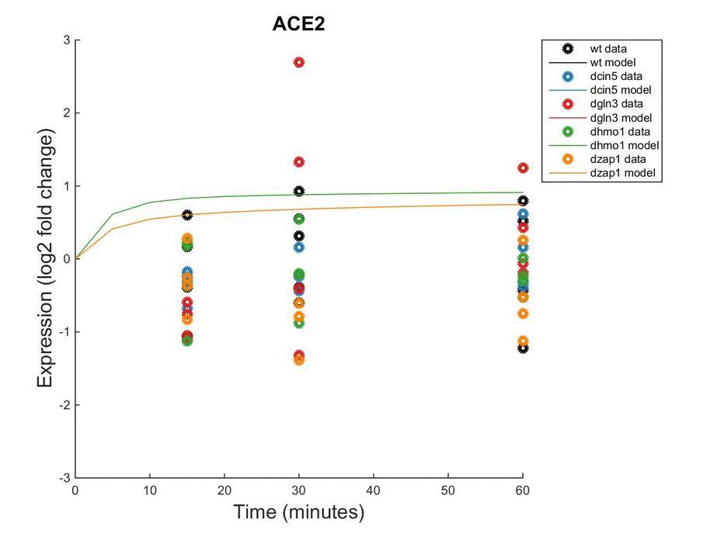
Forward Simulation of the Model Fits the Microarray Data
Notes:
Define alpha and beta and K

Slide 25
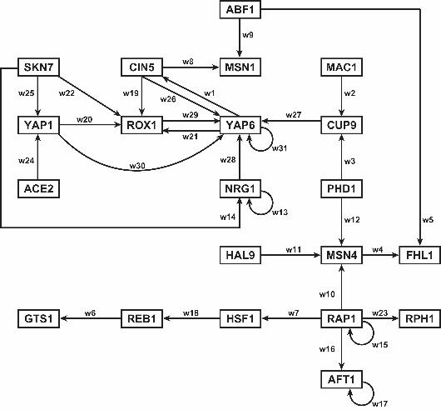
GRNsight Rapidly Generates GRN graphs Using Our Customizations to the Open Source D3 Library
Adobe Illustrator: several hours to create

Slide 26
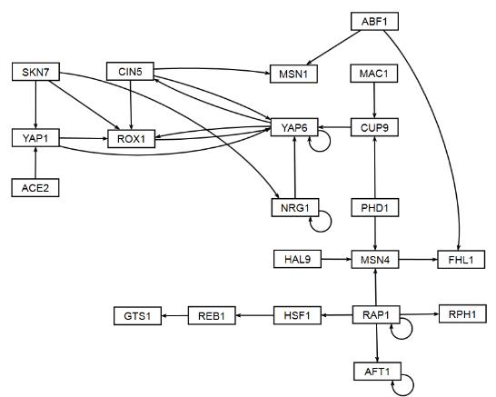
GRNsight Rapidly Generates GRN graphs Using Our Customizations to the Open Source D3 Library
GRNsight: 10 milliseconds to generate, 5 minutes to arrange

Slide 27
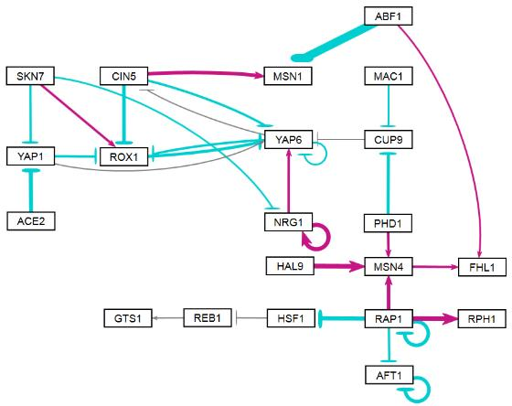
GRNsight Rapidly Generates GRN graphs Using Our Customizations to the Open Source D3 Library
activation
repression
weak influence
GRNsight: colored and variable thickness edges reveal patterns in data

Slide 28
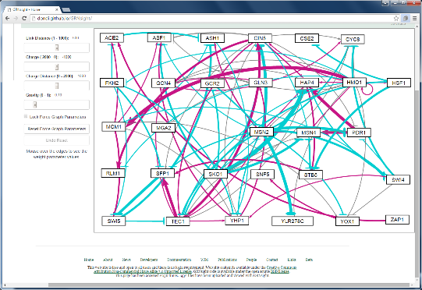
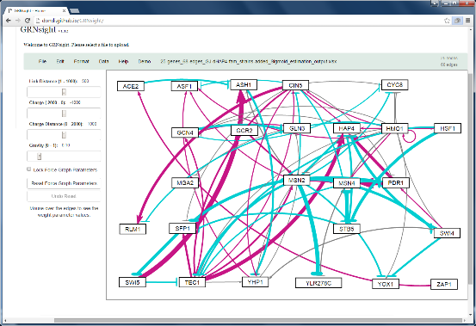
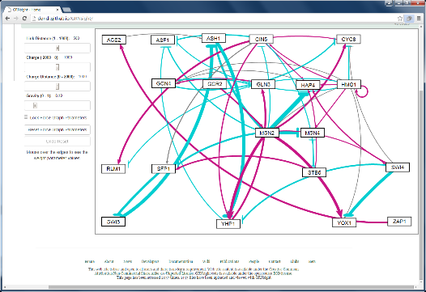
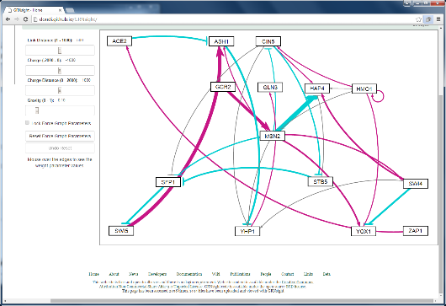
LSE to Minimum Theoretical LSE Ratio Does Not Change Drastically with Network Size
30 genes, 90 edges
LSE/min LSE = 1.41
25 genes, 68 edges
LSE/min LSE = 1.44
20 genes, 46 edges
LSE/min LSE = 1.44
15 genes, 28 edges
LSE/min LSE = 1.46

Slide 29
But Weights, Production Rates, and Threshold Parameter Values Do Fluctuate Based on Connectivity

Slide 30
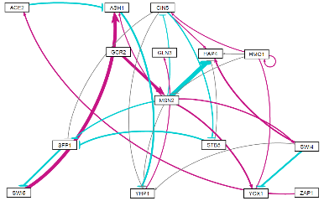
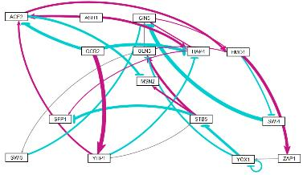
Generally, Networks with the Same Nodes, but Randomized Edges Perform More Poorly
YEASTRACT-derived
“random network 7”

Slide 31
Conclusions and Future Directions
Modeling and experimental evidence suggests that Gln3, Hap4, Hmo1, and Swi4 are involved in regulating the early response to cold shock in yeast.
Indirect effects are important as shown by comparing different size related networks and random networks.
Interesting, but inconclusive modeling results for Ash1 prompted us to investigate the phenotype of the deletion strain, which has shown to be cold sensitive.
We are investigating what data/network properties influence an individual gene’s model fit to data.

Slide 32

GRNsight: http://dondi.github.io/GRNsight/ GRNmap: http://kdahlquist.github.io/GRNmap/
Back row (left to right)
Brandon Klein
Mihir Samdarshi
Kevin McGee
Kevin Wyllie
K. Grace Johnson
Kristen Horstmann
Tessa Morris
Front row (left to right)
Maggie O’Neil
Monica Hong
Kam Dahlquist
Anindita Varshneya
Kayla Jackson
Not pictured
John David N. Dionisio
Ben G. Fitzpatrick
Nicole Anguiano
Juan Carrillo
Trixie Anne Roque
Chukwuemeka Azinge
Funding: NSF RUI, Kadner-Pitts Research Grant, LMU SURP,
LMU Honors Program, LMU Rains Research Assistant Program

Slide 33

Five Major Pragmatic Uses for Models in Biology and their Associated Benefits
Simple, unrealistic models help scientists explore complex systems.
Models can be used to explore unknown possibilities.
Models can lead to the development of conceptual frameworks.
Models can make accurate predictions.
Models can generate causal explanations.
Odenbaugh quoted in Svoboda & Passmore (2011)

